Slide 1
Assured Cloud transactions by maintaining equivalent accuracy, performance and precision
Under the Guidance of
Mr. MOHAMMED FAROOQ
Assistant Professor
By
ADICHERELA VENKATASAI (14831A0505)
AKSHARA SAI (14831A0514)
RISHITHA REDDY (14831A0519)

Slide 2
Abstract
Cloud servers are used to utilize the distributed transactional database systems, entities are collaborated to form testament of authorization as that are justified by collections of certified credentials. These proofs and credentials may be evaluated and collected over extended time under the risk of having the underlying authorization protocol or the user credentials being in inconsistent states. Therefore, it is possible for Policy-Based Authorization Systems which results in unsafe decisions, that might threaten sensitive resources. The criticality of the problem is highlighted, we define the trusted transactions while dealing with proofs of authorization. Accordingly, we propose several increasingly valid levels of policy consistency constraints, and present different enforcement approaches to guarantee the trust worthiness of transactions executing on cloud servers. Two-Phase Validation Commit protocol is proposed as a solution. We finally analyze the different approaches presented using both analytical (systematic) evaluation (estimation) of the overheads and match to guide the decision maker to which approach to use.

Slide 3
Introduction
Cloud computing has recently emerged , and it is booming in the present market . It provides scalability and elasticity
Cloud services often make heavy use of replication to ensure consistent performance and availability This consistency model is a variant of weak consistency that allows data to be inconsistent
Consistency states are achieved by maintaining ACID guarantees
By this we can have no inconsistent states in the consistency model

Slide 4
Existing System
In existing, Today’s cloud architectures are not without problems. Most cloud services built on top of a centralized architecture may suffer denial-of-service (DoS) attacks, unexpected outages, and limited pooling of computational resources. On the contrary, volunteer computing systems (or Desktop Grids) can easily aggregate huge potential computing power to tackle grand challenge science problems. They operate autonomously and meanwhile they could construct multiple VM instances for executing tasks submitted from others whenever they have idle resources.
Drawbacks:
It stores without encrypting the data, so unknown person can access it
Number of request from client so server will easy burden
It doesn’t check whether the user is valid person or not
No atomic commit protocol is used

Slide 5
Proposed System
The two-phase commit protocol (2PC) is a type of atomic commitment protocol (ACP). It is a distributed algorithm that coordinates all the processes that participate in a distributed atomic transaction on whether to commit or abort (roll back) the transaction .The protocol achieves its goal even in many cases of temporary system failure (involving process, network node, communication, etc. failures), and is thus widely utilized. However, it is not elastic to all possible failure configurations, and in rare cases user intervention is needed to remedy an outcome
Advantages:
The number of clients can access server will not burden by using of 2PVC protocol
It secures the data by encrypting it
It validates the user who is going to access the data
By using 2PVC protocol we can achieve the atomic commit protocol
The authorization of a user 2PVC protocol is done by prepare-to-commit technique

Slide 6
ALGORITHM: Two-phase Validation Commit -2PVC
1. Send “ Prepare-to-commit ” to all participants
2. Wait for all replies (Yes/No, True/False, and a set of policy versions for each unique policy)
3. If any participant replied No for Integrity check
4. ABORT
5. Identify the largest version for all unique policies
6. If all participants utilize the largest version for each unique policy
7. If any responded FALSE
8. ABORT
9. Otherwise
10. COMMIT
11. Otherwise , for participant with old policies
12. Send “Update” with the largest version number of each policy
13. Wait for all replies
14. Goto 5

Slide 7
System Requirements
HARDWARE REQUIREMENTS
PROCESSOR : PENTIUM IV 2.6 GHz, Intel Core 2 Duo.
RAM : 512 MB DD RAM
MONITOR : 15” COLOR
HARD DISK : 40 GB
SOFTWARE REQUIREMENTS
Front End : J2EE (JSP, SERVLET), STRUTS
Back End : MY SQL 5.5
Operating System : Windows 7
IDE : Eclipse

Slide 8
LITERATURE SURVEY
TITLE : Consistency Rationing in the Cloud: Pay only when it matters
AUTHOR : Yanwei Zhang, Yefu Wang, and Xiaorui Wang
YEAR : mar 2011.
DESCRIPTION
Cloud storage solutions promise high scalability and low cost. Existing solutions, however, differ in the degree of consistency they provide. Our experience using such systems indicates that there is a non-trivial trade-off between cost, consistency and availability. High consistency implies high cost per transaction and, in some situations, reduced availability. Low consistency is cheaper but it might result in higher operational cost .

Slide 9
TITLE : A High-Availability and Integrity layer for Cloud Storage
AUTHOR : Xiwang Yang,Yang Guo and Yong Liu
YEAR : May 2012.
DESCRIPTION:
We introduce HAIL (A High-Availability and Integrity layer ), a distributed
cryptographic system that permits a set of servers to prove to a client that a stored file is intact and retrievable .HAIL strengthens, formally unifies , and stream lines distinct approaches from the cryptographic and distributed systems communities.

Slide 10
System Architecture
User
Verify Credentials
Access Application
Step into Transaction Management
Transaction Management
Verify Data
Encrypt Information
Store in Server
Token Generate
Transaction Management
Forward to user
User
Request Information
Decrypt Data
Verify
Generate Token

Slide 11
MODULES
User interface
Quality of service
Authorization policies
Distributed transactions
Certificate Authorities

Slide 12
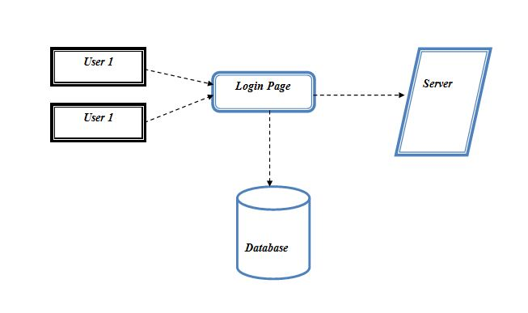
User interface Diagram
To connect with server user must give their username and password then only they can able to connect the server. If the user already exits directly can login into the server else user must register their details such as username, password and Email id, into the server. Server will create the account for the entire user to maintain upload and download rate. Name will be set as user id. . Logging in is usually used to enter a specific page

Slide 13
Quality of service
In this module, the data is given by customer requests arrive at each front-end proxy server. After the receiving the data it sense automatically to check the whether the server the total number of Server. And it based upon dynamically generated DNS responses, HTTP redirections, or using persistent HTTP proxies to tunnel requests. We assume that there exists a proxy/DNS server collocated with each request source.
USER
TEMPOARY STORAGE
Server 2
QOS
Server 1

Slide 14
Authorization Policies
In this model, once user add the document in the cloud server and its compute the file and also analysis the user. It’s also analysis file belong to which category and pass the file in to particular database in cloud environment.
Analytic Hierarchy Process
USER
File
ANALYZER
Output

Slide 15
Distributed Transactions
In this model we going to get value from authorization model and we will store the data in data in particular cloud database in cloud environment using transaction management in the system. Transaction management used for safe transaction process in file transfer system. It’s using a commit or roll back in transaction system
Transaction protocol
USER
File
Authorization
Policies
OUTPUT
Atomic protocol

Slide 16
USER
FILE
Uploading
Authorization
Policies
CA System
Certificate Authorities
In this model we are going to analysis the file transfer system are monitor by a third party person .see entire transaction those who are pass the file in cloud they are file are belong to the particular database or un wanted are store in any database.
OUTPUT

Slide 17
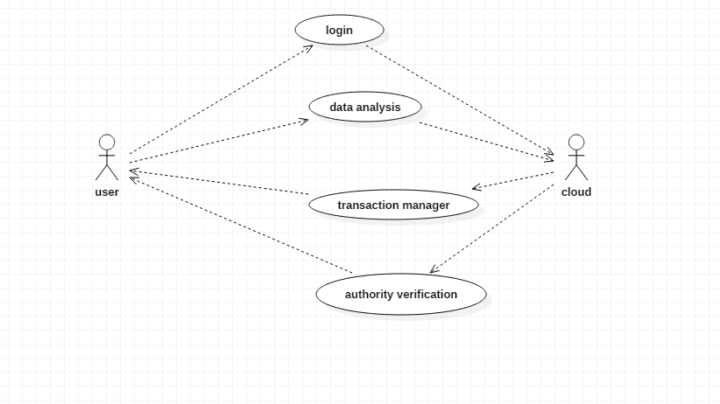
Uml Diagrams
Usecase diagram

Slide 18
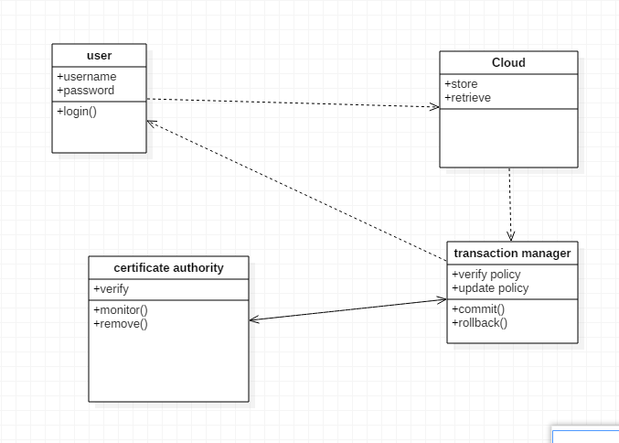
Class diagram

Slide 19
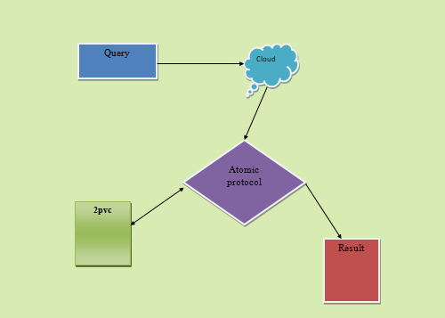
Object diagram

Slide 20
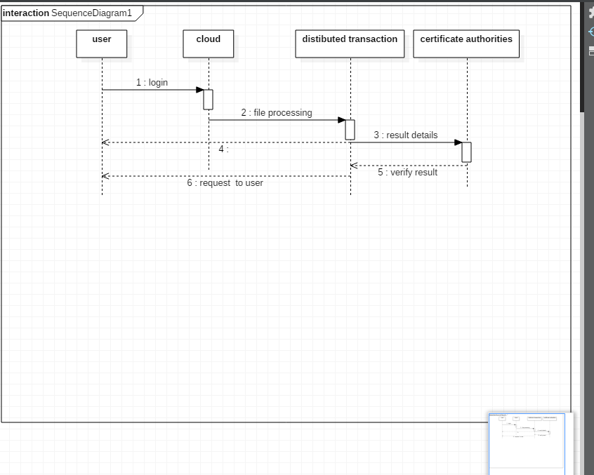
Sequence diagram

Slide 21
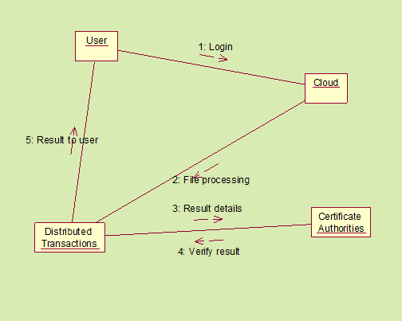
Collaboration diagram

Slide 22
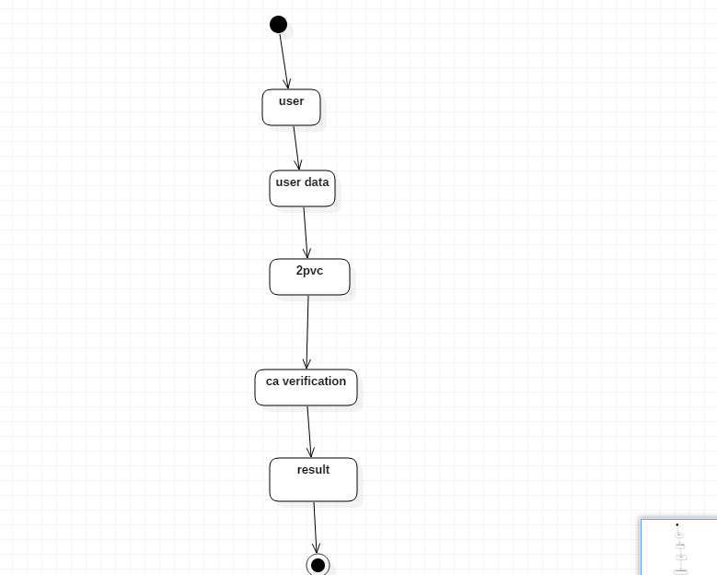
State diagram

Slide 23
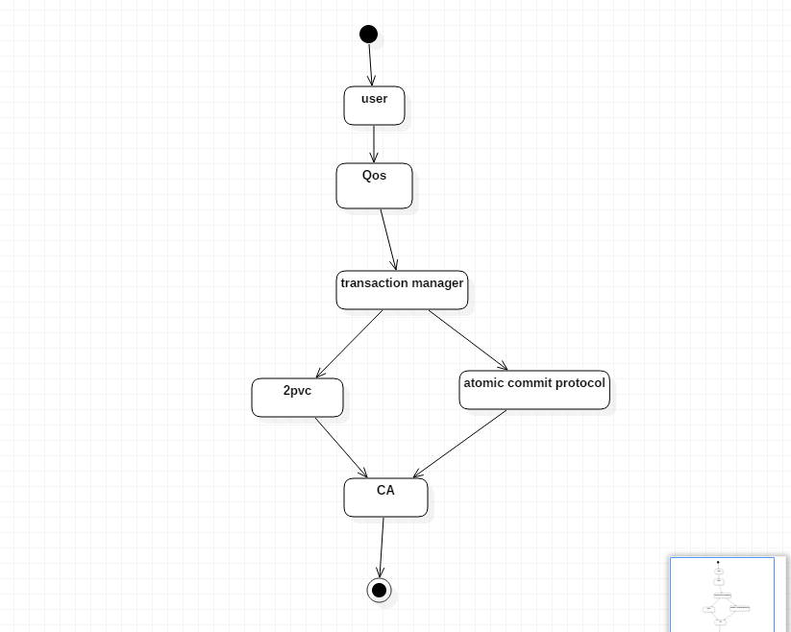
Activity diagram

Slide 24
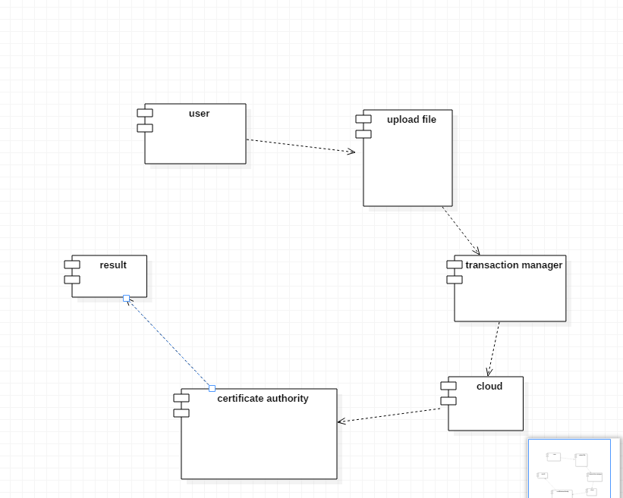
Component diagram

Slide 25
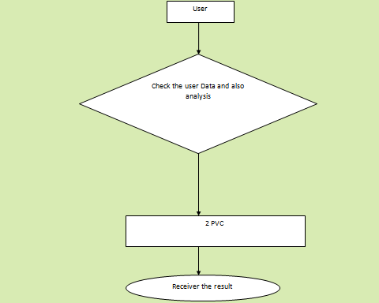
Data flow diagram

Slide 26
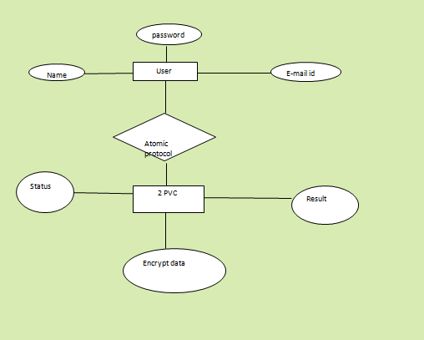
E-R diagram

Slide 27
Contents
Login page
Register page
Admin cloud
Client search
Test cases

Slide 28
LOGIN page:
<%@ page language="java" contentType="text/html; charset=ISO-8859-1"
pageEncoding="ISO-8859-1"%>
<!DOCTYPE html PUBLIC "-//W3C//DTD HTML 4.01 Transitional//EN" "http://www.w3.org/TR/html4/loose.dtd">
<html>
<head>
<meta http-equiv="Content-Type" content="text/html; charset=ISO-8859-1">
<title>ARaynorDesign Template</title>
<meta name="description" content="free website template" />
<meta name="keywords" content="enter your keywords here" />
<meta http-equiv="content-type" content="text/html; charset=utf-8" />
<link rel="stylesheet" type="text/css" href="css/style.css" />
<script type="text/javascript" src="js/jquery.min.js"></script>
<script type="text/javascript" src="js/jquery.easing.min.js"></script>
<script type="text/javascript" src="js/jquery.nivo.slider.pack.js"></script>
<script type="text/javascript">
$(window).load(function() {
$('#slider').nivoSlider();
});
</script>
</head>

Slide 29
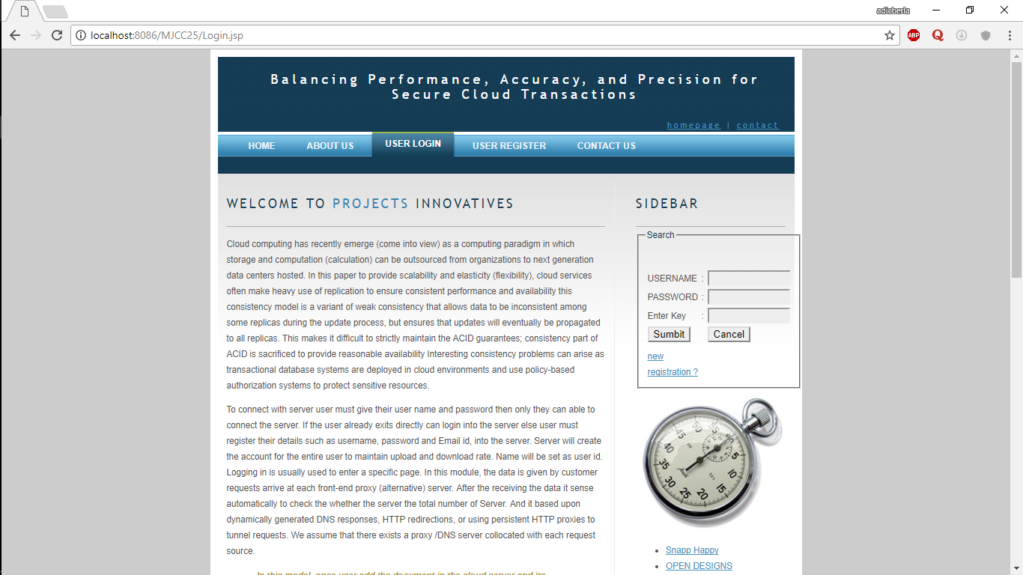
Login page

Slide 30
Register page:
<%@ page language="java" contentType="text/html; charset=ISO-8859-1"
pageEncoding="ISO-8859-1"%>
<!DOCTYPE html PUBLIC "-//W3C//DTD HTML 4.01 Transitional//EN" "http://www.w3.org/TR/html4/loose.dtd">
<html>
<head>
<meta http-equiv="Content-Type" content="text/html; charset=ISO-8859-1">
<title>ARaynorDesign Template</title>
<meta name="description" content="free website template" />
<meta name="keywords" content="enter your keywords here" />
<meta http-equiv="content-type" content="text/html; charset=utf-8" />
<link rel="stylesheet" type="text/css" href="css/style.css" />
<script type="text/javascript" src="js/jquery.min.js"></script>
<script type="text/javascript" src="js/jquery.easing.min.js"></script>
<script type="text/javascript" src="js/jquery.nivo.slider.pack.js"></script>
<script type="text/javascript">
$(window).load(function() {
$('#slider').nivoSlider();
});
</script>

Slide 31
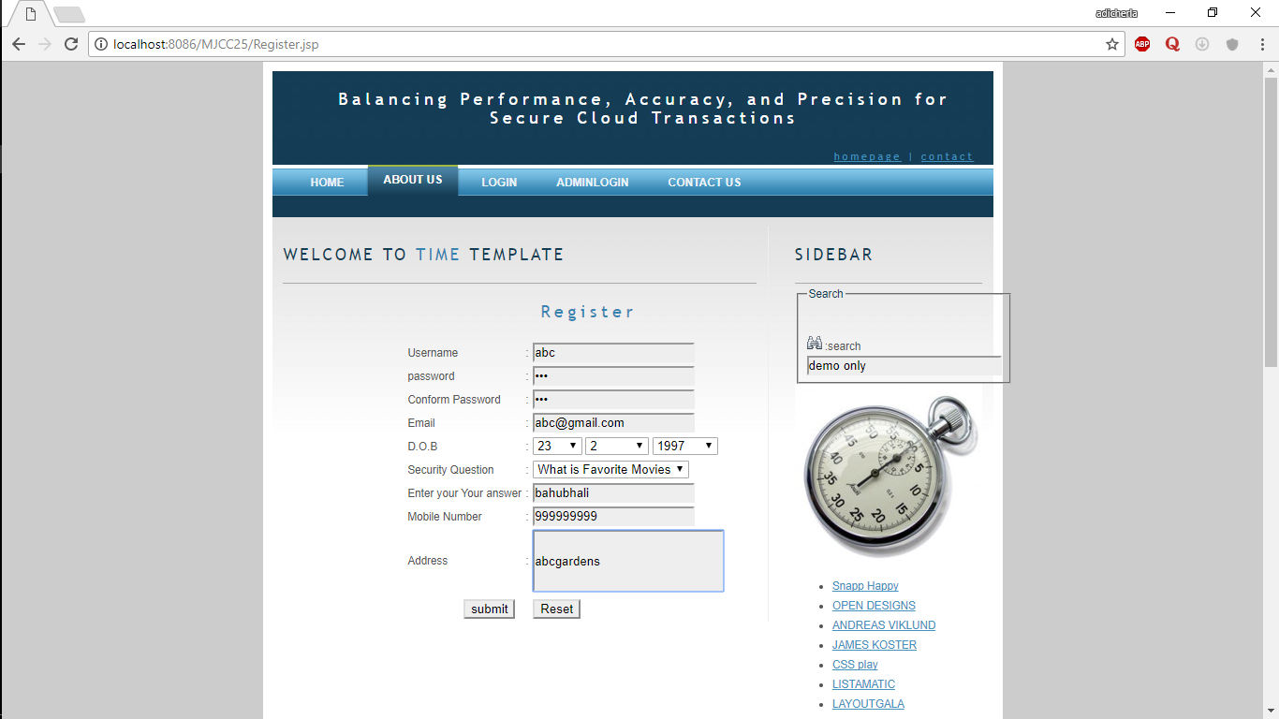
User registration page

Slide 32
ADMINCLOUD:
/**
* Servlet implementation class Admincloud
*/
public class Admincloud extends HttpServlet {
private static final long serialVersionUID = 1L;
/**
* @see HttpServlet#HttpServlet()
*/
public Admincloud() {
super();
// TODO Auto-generated constructor stub
}
/**
* @see HttpServlet#doGet(HttpServletRequest request, HttpServletResponse response)
*/
protected void doGet(HttpServletRequest request, HttpServletResponse response) throws ServletException, IOException {
// TODO Auto-generated method stub
}

Slide 33
/**
* @see HttpServlet#doPost(HttpServletRequest request, HttpServletResponse response)
*/
protected void doPost(HttpServletRequest request, HttpServletResponse response) throws ServletException, IOException {
// TODO Auto-generated method stub
ArrayList al=new ArrayList();
al.add(request.getParameter("aname"));
al.add(request.getParameter("apass"));
System.out.println(al);
String adminname=al.get(0).toString();
String adminpassword=al.get(1).toString();
if(adminname.equalsIgnoreCase("admin")&&adminpassword.equalsIgnoreCase("admin"))
{
response.sendRedirect("welcome.jsp");
}
else
{ response.sendRedirect("admin.jsp");
}
}

Slide 34
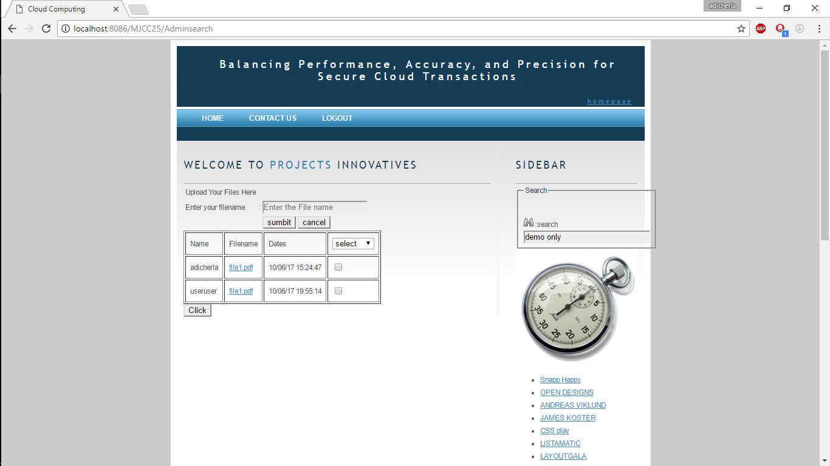
Admin cloud

Slide 35
CLIENT SEARCH:
* Servlet implementation class Client1Search
*/
public class Client1Search extends HttpServlet {
private static final long serialVersionUID = 1L;
/**
* @see HttpServlet#HttpServlet()
*/
public Client1Search() {
super();
// TODO Auto-generated constructor stub
}
/**
* @see HttpServlet#doGet(HttpServletRequest request, HttpServletResponse response)
*/
protected void doGet(HttpServletRequest request, HttpServletResponse response) throws ServletException, IOException {
// TODO Auto-generated method stub
}

Slide 36
/**
* @see HttpServlet#doPost(HttpServletRequest request, HttpServletResponse response)
*/
protected void doPost(HttpServletRequest request, HttpServletResponse response) throws ServletException, IOException {
/*String query=request.getParameter("query");
String res=dbpack.Client1DB.fileSearch(query);
if(res.equals("file found"))
{
response.sendRedirect("results.jsp");
}
else
response.sendRedirect("welcome.jsp");
*/

Slide 37
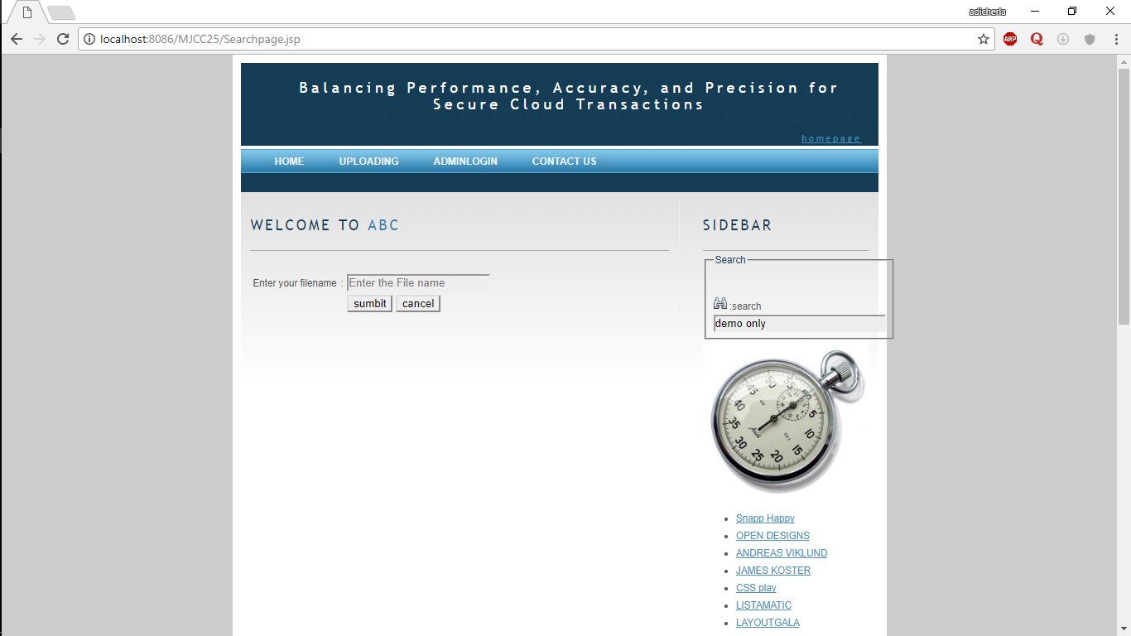
Client Search

Slide 38
Test case for registration
Sno | Member | Type | Successful | Unsuccessful
1 | User | Registration | Login.jsp | error.jsp
Test scenario | Test steps | Test data | Expected result
Check user registration with vaild input | Enter 1.Username 2.Password 3.Conform password 4.Email 5.D0B 6.Security question 7.Enter your your answer 8.Mobile number 9.address | 1.Abc 2.Abc 3.Abc 4.abc@gmail.com 5.8 -10-11 6. What is Favorite Sports 7. Crckt 8. 9900889900 9.hyd | Your securitykey *******

Slide 39
Test scenario | Test steps | Test data | Expected result
Check user registration with vaild input | Enter 1.Username 2.Password 3.Conform password 4.Email 5.D0B 6.Security question 7.Enter your your answer 8.Mobile number 9.address | 1.Abc 2. 3. 4.abc@gmail.com 5.8 -10-11 6. What is Favorite Sports 7. Crckt 8. 9900889900 9.hyd | Please fill this field

Slide 40
Test case for login
Test case id | Test scenario | Test steps | Expected result | result
TC1 | Check login name with invalid data | Enter 1.Username 2.Password 3.Enter key | Username=user1 Password=user1 Enter key=12345 | Enter valid details
TC2 | Check login name with valid data | Enter 1.Username 2.Password 3.Enter key | Username=user1 Password=user1 Enter key=5752807 | successful

Slide 41
Test case for admin
Test case id | Test scenario | Test states | Test data | Result
TC10 | Check admin login with invalid data | Enter 1.Username 2.Password | Username=admin Password=aadmin1 | Enter valid details
TC11 | Check admin login with valid data | Enter 1.Username 2.Password | Username=admin Password=admin | successful

Slide 42
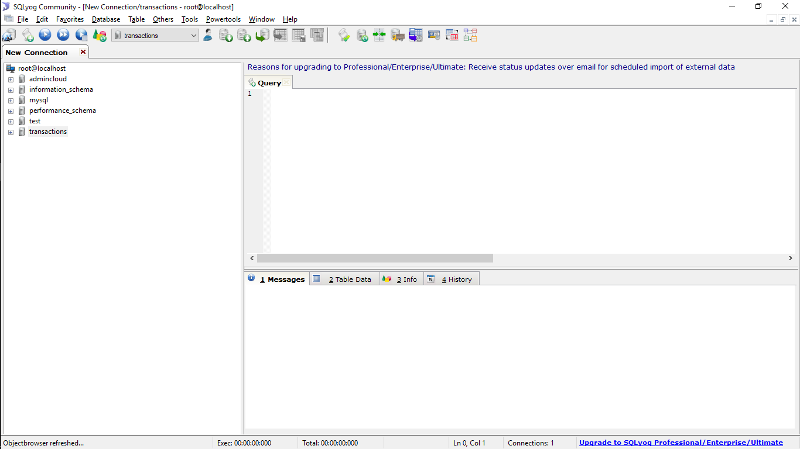
Database screenshots

Slide 43
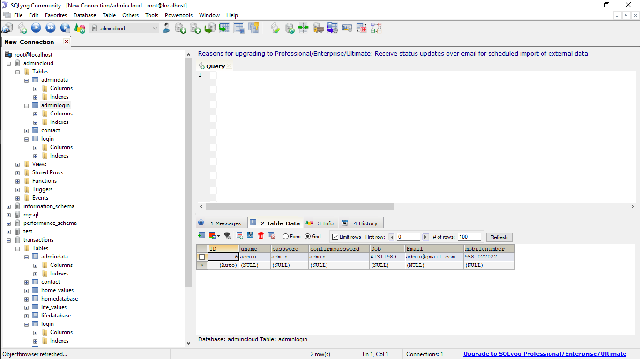

Slide 44
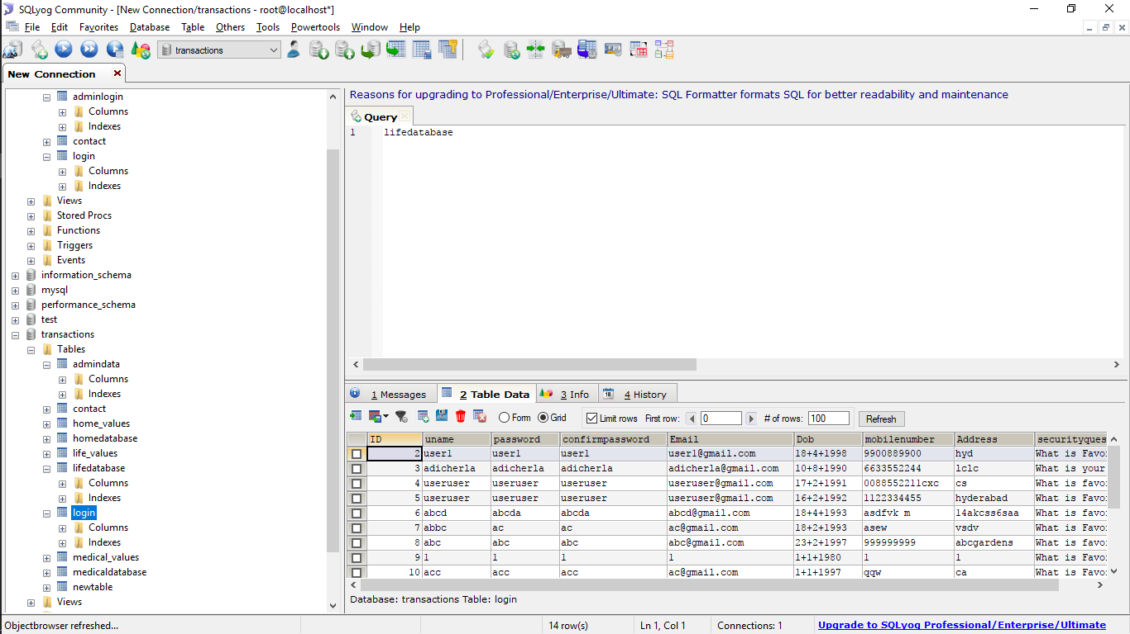

Slide 45
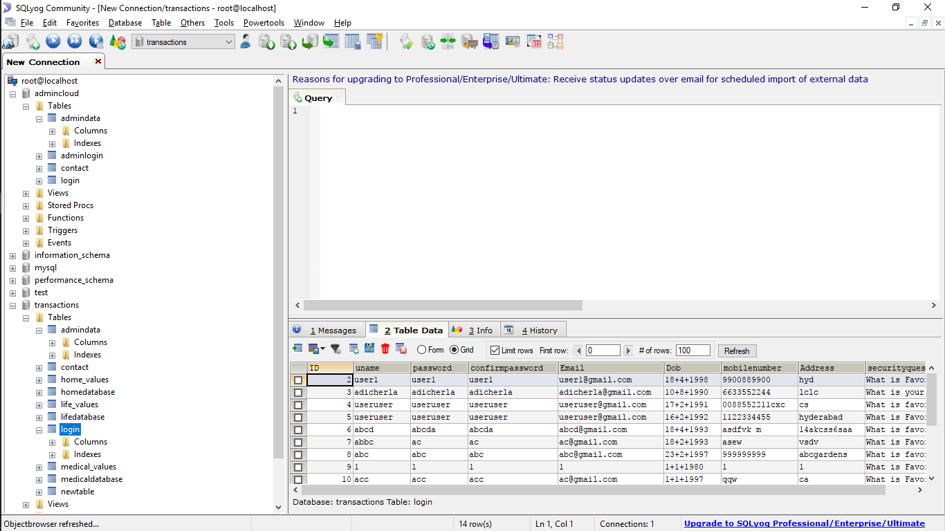

Slide 46
Conclusion
Despite the popularity of cloud services and their wide adoption by enterprises and governments, loud providers still lack services that guarantee both data and access control policy consistency across multiple data centers. In this paper, we identified several consistency problems that can arise during cloud-hosted transaction processing using weak consistency models, particularly if policy-based authorization systems are used to enforce access controls. To this end, developed a variety of lightweight proof enforcement and consistency models—i.e., Deferred, Punctual, Incremental, and Continuous proofs, with view or global consistency—that can enforce increasingly strong protections with minimal runtime overheads.

Slide 47
Future Enhancement
We identified several consistency problems that can arise during cloud-hosted transaction processing using weak consistency models, particularly if policy-based authorization systems are used to enforce access controls. We used workloads to experimentally evaluate implementations of our proposed consistency models relative to three core metrics: transaction processing performance, accuracy and precision. We found that high performance comes at a cost: Deferred and Punctual proofs had minimal overheads, but failed to detect certain types of consistency problems. And proofs were faster than view consistency ones in the few cases when the latest policy happens to match the policy used by all participating servers and as a result all servers skip the reevaluation step of 2PVC.

Slide 48
References
[1] M. Armbrust et al., “Above the Clouds: A Berkeley View of Cloud Computing,” technical report, Univ. of California, Feb. 2009.
[2] S. Das, D. Agrawal, and A.E. Abbadi, “Elastras: An Elastic Transactional Data Store in the Cloud,” Proc. Conf. Hot Topics in Cloud Computing (USENIX HotCloud ’09), 2009.
[3] A.J. Lee and M. Winslett, “Safety and Consistency in Policy-Based Authorization Systems,” Proc. 13th ACM Conf. Computer and Comm. Security (CCS ’06), 2006.
[4] M. Myers, R. Ankney, A. Malpani, S. Galperin, and C. Adams, “X.509 Internet Public Key Infrastructure Online Certificate Status Protocol - Ocsp,” RFC 2560, http://tools.ietf.org/html/rfc5280, June 1999.
[5]D. Cooper et al., “Internet x.509 Public Key Infrastructure Certificate and Certificate Revocation List (CRL) Profile,” RFC 5280, http://tools.ietf.org/html/rfc5280, May 2008.

Slide 49
[6] J. Li, N. Li, and W.H. Winsborough, “Automated Trust Negotiation Using Cryptographic Credentials,” Proc. 12th ACM Conf. Computer and Comm. Security (CCS ’05), Nov. 2005.
[7] L. Bauer et al., “Distributed Proving in Access-Control Systems,” Proc. IEEE Symp. Security and Privacy, May 2005.
[8] J. Camenisch and A. Lysyanskaya, “An Efficient System for Non- Transferable Anonymous Credentials with Optional Anonymity Revocation,” Proc. Int’l Conf. Theory and Application of Cryptographic Techniques: Advances in Cryptology (EUROCRYPT ’01), 2001
[9] P.K. Chrysanthis, G. Samaras, and Y.J. Al-Houmaily, “Recovery and Performance of Atomic Commit Processing in Distributed Database Systems,” Recovery Mechanisms in Database Systems, Prentice Hall PTR, 1998.
[10] G. DeCandia et al., “Dynamo: Amazons Highly Available Key- Value Store,” Proc. 21st ACM SIGOPS Symp. Operating Systems Principles (SOSP ’07), 2007.

